Slide 1

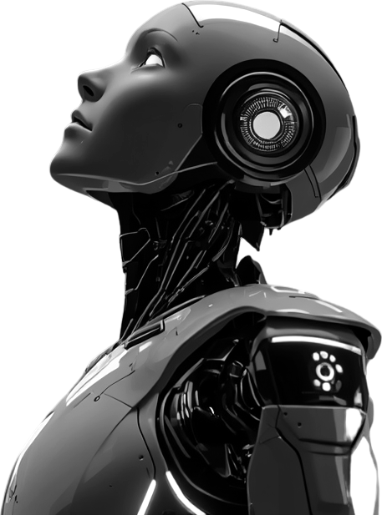
Cognitive Evolution Engine (CEE):
A Middleware Framework for Self-Evolving Physical AI Robots Using Reflective Knowledge Intelligence
FINAL YEAR PROJECT REVIEW | BATCH 13
TEAM
GUIDES
Swarna M
Vishal S S M
Aanandha Subash S
Ms. Usha B, M.Tech (Ph.D)
Ms. Rekhadevi B, M.Tech

Slide 2
Abstract
BACKGROUND
Autonomous robots improve mainly through machine-learning retraining on large datasets, yet cannot reason about failures, reuse experience or adapt to changing conditions.
The Cognitive Evolution Engine (CEE) is a middleware between perception and decision-making. It converts observations into operational knowledge through seven cooperating components, so that knowledge evolves through experience and reflective reasoning rather than continual retraining.
A functional prototype, a mobile-robot simulation with MQTT telemetry, demonstrates event detection, rule generation and knowledge retention for navigation failures.
SEVEN CEE COMPONENTS
01
Experience Interpreter
02
Reflective Reasoning Engine
03
Operational Knowledge Graph
04
Knowledge Evolution Engine
05
Intelligent Forgetting Module
06
Curiosity Engine
07
Knowledge Transfer Engine
KEYWORDS
Autonomous Robots · Physical AI · Cognitive Middleware · Reflective Reasoning · Knowledge Graph · Lifelong Learning · Explainable AI · ROS 2

Slide 3
Introduction
BACKGROUND
Robots are now deployed in logistics, manufacturing, inspection, health care and service settings, where conditions change continuously. Sustained autonomy requires robots to interpret past experience, retain relevant operational information and apply it to future work.
CURRENT PRACTICE
PROPOSED: CEE
Improvement relies on retraining and large datasets
Sensor data drives prediction or reaction, but experience is not recorded or preserved
Continual learning, memory and reflection are studied in isolation or in task-specific systems
A cognitive middleware between perception and decision-making
Interprets sensor data and action outcomes, detects key events and generates operational knowledge
Experience, reflection, evolution and reuse in one cognitive layer

Slide 4
Problem Statement
BACKGROUND
01
02
03
Adaptation depends on retraining and large-scale data, which is slow and computationally expensive.
Robots store raw sensor data rather than reusable operational knowledge.
Failures cannot be explained, and lessons from past missions are not learned.
04
05
CONSEQUENCE
Knowledge from one robot is hard to transfer to others without retraining.
Lack of knowledge evolution, intelligent forgetting and continuous adaptation.
Task-specific robots, frequent human intervention and limited long-term autonomy.

Slide 5




Objective
BACKGROUND
Decouple learning from retraining
Explainable AI in robotics
Engineer a real-time cognitive middleware that removes reliance on cloud-based ML, so robots evolve on the edge.
Translate multi-sensor anomalies (wheel slip, collision) into transparent, human-readable rules through reflective reasoning.
Active memory architecture
Validate physical autonomy
Build an Operational Knowledge Graph that retrieves vital lessons instantly and intelligently forgets obsolete data.
Deploy CEE on a physical, IoT-enabled rover and demonstrate real-time adaptation without human intervention.

Slide 6
Literature Survey
RELATED WORK
REF | APPROACH | WHAT THE STUDY SHOWS
[1] | Continual learning for robotics | Defines frameworks and strategies for continual learning; retaining and recalling earlier knowledge remains an obstacle.
[2] | Lifelong open-ended learning | Cognitive architectures for lifelong autonomy; real-world Physical AI implementation remains an open problem.
[3] | Cognitive architecture (CRAM 2.0) | Generalized action plans for everyday manipulation; focused on task plans, not evolving operational knowledge.
[4] | Multi-memory agentic framework | Brain-inspired memory for embodied learning; reflective rule generation and forgetting are not its focus.
[5] | Lifelong reinforcement learning | Preserves and combines knowledge across tasks, but keeps it in learned policies rather than explainable rules.

Slide 7
Research Gap
RELATED WORK
STUDIED INDIVIDUALLY
CEE INTEGRATES, IN ONE REUSABLE MIDDLEWARE
Continual learning
Knowledge graphs
Lifelong cognition
Cognitive architectures
Experience interpretation
Reflective reasoning
Operational knowledge generation
Intelligent forgetting
Knowledge evolution
Cross-robot knowledge transfer
Limited work unifies these capabilities for Physical AI robots. CEE closes the gap with an integrated framework for experience-driven, explainable and continuously evolving robotic intelligence.

Slide 8
Key Contributions
APPROACH
01
Cognitive middleware architecture
A cognitive layer positioned between robotic perception and decision-making.
02
Experience-to-rule conversion
A rule-based cognitive system maps interpreted robot state to operational rules.
03
Persistent operational memory
Generated rules are stored in a repository for future robotic use.
04
Prototype implementation
Evaluated on a mobile-robot simulation with MQTT telemetry transmission.

Slide 9
Proposed Methodology
APPROACH
CEE sits between the robot's perception and decision-making layers.
01
02
03
04
Sense
Interpret
Evolve
Adapt
Real-time data from multiple sensors.
Experience interpretation and reflective reasoning produce operational knowledge.
Knowledge Graph refined by evolution, pruned by forgetting, shared by transfer.
Evolved knowledge guides decisions and reduces repeated retraining.
PERCEPTION
COGNITIVE EVOLUTION ENGINE
DECISION-MAKING

Slide 10
Architecture Diagram
APPROACH
PHYSICAL ENVIRONMENT & MISSION
DATA COLLECTION & EDGE SENSING
Warehouse / Environment
Robot interacts with environment
Camera
IMU
Ultrasonic
Wheel Encoder
ESP32
Raw sensor data
DATA PRE-PROCESSING
DATA COMMUNICATION
Raw Data
Filtering
Synchronization
Normalization
MQTT / Mosquitto
Sensor Telemetry
Data Buffer
Clean data
COGNITIVE EVOLUTION ENGINE
DECISION & CONTROL
Experience Interpreter
Event / Anomaly Detection
Reflective Reasoning
Knowledge Evolution
Rule Generation
Operational Rule
Decision Engine
ROS 2
L298N
Motors
4WD Rover
MISSION OUTCOME
Robot Performance
Success / Failure
New Experience
CEE
CEE

Slide 11
Flowchart
APPROACH
START
Mission Assigned
Navigation / Robot Task
Sensor Data Acquisition
IMU + Wheel Encoder + Ultrasonic Sensors
Monitor Robot Behaviour
Compare Expected vs Observed Robot Behaviour
Anomaly Detected?
NO
COGNITIVE EVOLUTION ENGINE
YES
Adapt Robot Decision / Behaviour
Retrieve Relevant Previous Knowledge
Update Operational Knowledge Graph
Operational Knowledge Generation
Reflective Reasoning
Analyse context, cause & consequence
Experience Interpretation
Execute Action: Motor Control / Navigation Response
Evaluate Outcome
Did the adapted action improve the situation?
Store New Experience
Monitor Robot Behaviour

Slide 12
Cognitive Rule Generation
APPROACH
Telemetry
State Interpretation
Event Detection
Rule Generation
Knowledge Retention
TELEMETRY MESSAGE
M_{t} = {R_{t}, A_{t}, P_{t}, U_{t}, T_{t}}
R_{t} average wheel speed
A_{t} IMU acceleration
P_{t} pitch angle
U_{t} ultrasonic distance
T_{t} temperature
Simulator → MQTT publisher → Broker → CEE
EVENT DETECTION
I_{t} = f_{I}(x_{t}), E_{t} = f_{A}(x_{t})
Wheel slip
R_{t} > 120 ∧ A_{t} < 0.8
Rule: reduce motor RPM by 50%
Obstacle proximity
U_{t} < 25 cm ∧ R_{t} > 50
KNOWLEDGE & LATCHING
K_{i} = (ID_{i}, E_{i}, R_{i})
K_{t+1} = K_{t} ∪ {K_{i}}
A new rule is created only when
L_{t−1} = 0 ∧ L_{t} = 1
An active anomaly (L_{t−1} = L_{t} = 1) adds no duplicate entry.

Slide 13


Hardware & Software Components
APPROACH
Software Stack
Sensing Inputs
Physical Rover
IMPLEMENTED IN THE PROTOTYPE
SIMULATED TELEMETRY CHANNELS
PLANNED FUTURE WORK
SIMULATION & CONTROL
MOTION
COMPUTE
Mobile-robot simulator with manual keyboard control
Average wheel speed (R) and IMU acceleration (A)
Raspberry Pi 4 (CEE host), ESP32 NodeMCU
MESSAGING
ATTITUDE & RANGE
SENSING
MQTT telemetry via Mosquitto / HiveMQ brokers
Pitch angle (P) and ultrasonic obstacle distance (U)
MPU-6050 IMU, wheel encoders, HC-SR04 ultrasonic sensors
COGNITION, MEMORY & UI
SYSTEM HEALTH
ACTUATION
Rule-based reasoning, rule archive, live dashboard
Temperature (T) for thermal-overload detection
4WD chassis with L298N motor drivers; ROS 2 integration
The prototype is evaluated in simulation; deployment on a physical rover is planned as future work.

Slide 14
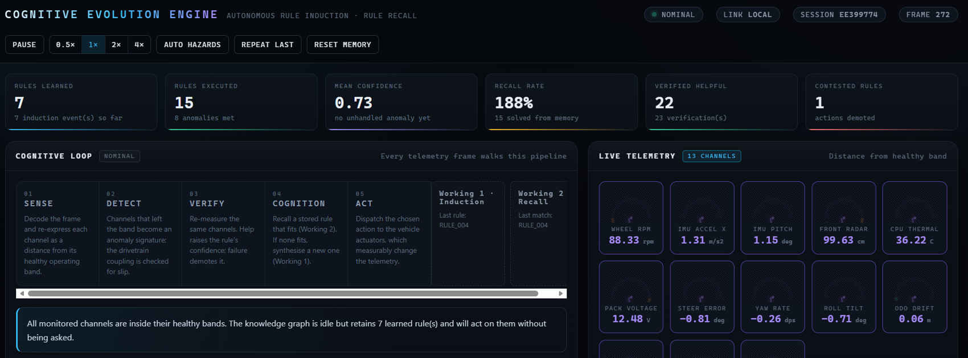
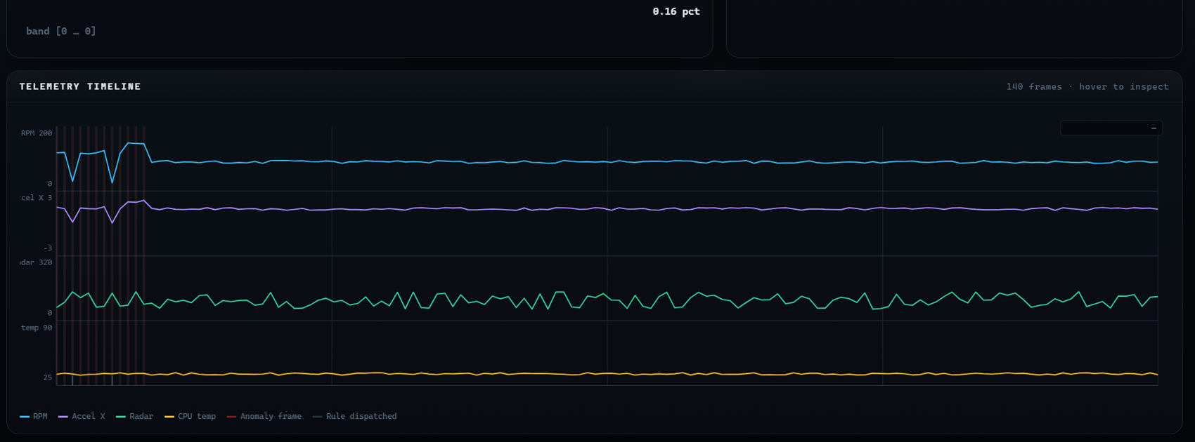
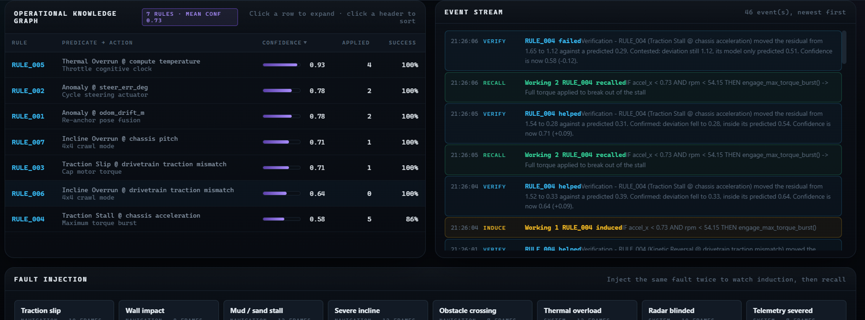
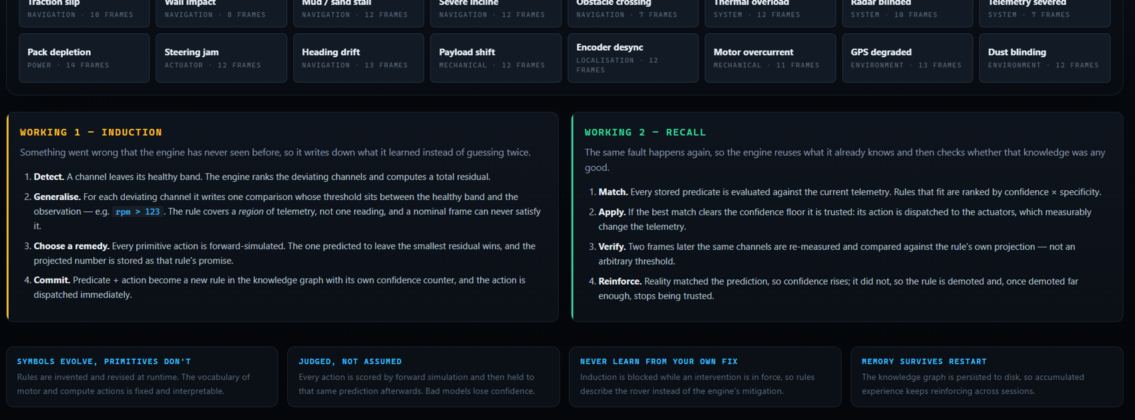
Implementation Output
EXECUTION
Live dashboard: learned rules, recall rate, cognitive loop
Telemetry timeline with anomaly frames and rule dispatch
Knowledge graph: rule confidence and live event stream
Fault injection: induction (Working 1) and recall (Working 2)

Slide 15
Evaluation Metrics
EXECUTION
EDA
Event Detection Accuracy
N_{c} / N × 100
Share of test events identified correctly (N tests, N_{c} correct)
RGR
Rule Generation Rate
N_{r} / N_{c} × 100
Correctly detected events (N_{c}) for which the ideal rule was generated (N_{r})
KRR
Knowledge Retention Rate
N_{k} / N_{r} × 100
Generated rules (N_{r}) successfully retained in the repository (N_{k})
DSR
Duplicate Suppression Rate
(1 − N_{d} / N_{r}) × 100
Penalises events whose rule was generated more than once (N_{d})
Tc
Cognitive Response Latency
T_{c} = T_{r} − T_{e}
Time from event received (T_{e}) to rule generated (T_{r})
TPS
Telemetry Processing Rate
N_{m} / T
Telemetry messages (N_{m}) processed in interval T
Indicators for the deterministic CEE pipeline, used in place of conventional machine-learning metrics.

Slide 16
Results & Discussion
EXECUTION
WHAT THE PROTOTYPE DEMONSTRATES
EXAMPLE RULE
IF wheel slip is detected
R_{t} > 120 ∧ A_{t} < 0.8
THEN reduce motor RPM by 50%
1
Complete pipeline: telemetry, event interpretation, rule creation and knowledge retention
2
Wheel slip, telemetry failure, thermal overload, sensor blindness and collision, each mapped to a rule
3
Rules persist after the anomaly ends, unlike transient event displays
SCOPE OF THE FINDINGS
Deterministic reasoning shows the practical success of the prototype, not general learning or autonomous knowledge growth.
4
Anomaly latching blocks duplicate rule entries while a fault continues

Slide 17
Challenges & Solutions
EXECUTION
TECHNICAL CHALLENGE
ENGINEERING SOLUTION
Dependency conflicts in cutting-edge environments
Native kinematic engine
A custom kinematic physics and raycasting engine, built on Tkinter, bypassed the external C++ dependencies.
Standard physics and 3D libraries failed to compile on bleeding-edge Python 3.14.
Network firewalls blocking IoT telemetry
Broker failover and abstraction
The pipeline swaps instantly between cloud brokers (HiveMQ / Mosquitto), with mobile-hotspot local fallbacks.
Strict campus firewalls blocked standard MQTT ports, cutting the Edge-to-CEE link.

Slide 18
Project Timeline
EXECUTION
PHASE
W1
W2
W3
W4
W5
W6
W7
W8
W9
W10
W11
W12
Hardware Foundation
W1–W2
Connectivity Pipeline
W3–W4
Core AI Development
W5–W7
Knowledge Integration
W8–W9
Physical Validation
W10–W11
Finalization & IEEE
W12

Slide 19
Future Work
OUTCOME
01
Multimodal Experience Integration
02
Advanced Knowledge Evolution
Add visual, auditory and other sensor modalities for richer experience interpretation.
Knowledge confidence, revision, prioritization and forgetting for reliable knowledge.
03
Cross-Robot Knowledge Transfer
04
Autonomous Cognitive Adaptation
Share learned operational knowledge across robots in similar environments.
Extend reflective reasoning and retrieval to navigation and task-level decisions.
Toward lifelong robotic intelligence
05
Large-Scale Physical Validation
Evaluate CEE across diverse environments, conditions and extended-duration tasks.

Slide 20
Conclusion
OUTCOME
CEE is a middleware framework for experience-driven learning in Physical AI robots, unifying experience interpretation, anomaly detection, reflective reasoning, operational knowledge and knowledge evolution in one cognitive loop.
Real-world experience becomes structured, reusable knowledge that supports future decisions: a foundation for more adaptive, reusable and explainable robotic intelligence.
Experience
Reasoning
COGNITIVE LOOP
Adaptation
Knowledge

Slide 21
References
OUTCOME
[1]
T. Lesort, V. Lomonaco, A. Stoian, D. Maltoni, D. Filliat, and N. Díaz-Rodríguez, “Continual learning for robotics: Definition, framework, learning strategies, opportunities and challenges,” Information Fusion, vol. 58, pp. 52–68, 2020.
[2]
A. Romero, F. Bellas, and R. J. Duro, “A perspective on lifelong open-ended learning autonomy for robotics through cognitive architectures,” Sensors, vol. 23, no. 3, Art. no. 1611, Feb. 2023.
[3]
M. Beetz, G. Kazhoyan, and D. Vernon, “Robot manipulation in everyday activities with the CRAM 2.0 cognitive architecture and generalized action plans,” Cognitive Systems Research, vol. 92, Art. no. 101375, Jun. 2025.
[4]
M. Lei et al., “RoboMemory: A brain-inspired multi-memory agentic framework for interactive environmental learning in physical embodied systems,” arXiv:2508.01415, 2026.
[5]
Y. Meng, Z. Bing, X. Yao, K. Chen, K. Huang, Y. Gao, F. Sun, and A. Knoll, “Preserving and combining knowledge in robotic lifelong reinforcement learning,” Nature Machine Intelligence, vol. 7, pp. 256–269, Feb. 2025.

Slide 22
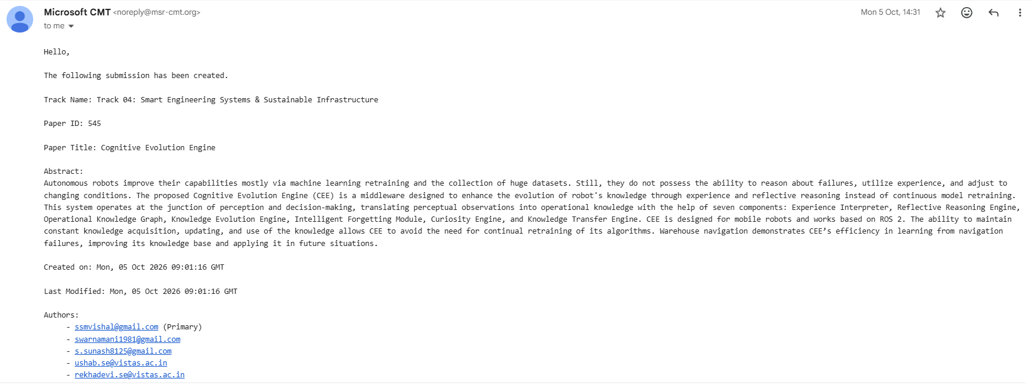
Conference Submission
OUTCOME
Microsoft CMT confirmation | Paper ID 545 | Track 04: Smart Engineering Systems & Sustainable Infrastructure | 5 Oct 2026

Slide 23
Thank You
Questions and discussion
Cognitive Evolution Engine (CEE) | Batch 13

